Slide 1
LS 225 Lesson 1: Objects
April 22, 2020

Slide 2
List of assignments
Objects and methods
Walkthrough: object methods
Practice: objects
Mutating objects
Practice: mutating objects
Functions as object factories
Practice: functions as object factories
Object orientation
Practice: object orientation
Summary
Quiz

Slide 3
List of code snippets
Objects
Add, remove, update and index a collection
Invoice app to add invoice, pay off invoice, print out paid and owed amounts
A vehicle object factory
A country object factory
Updating the vehicle object factory
Tools inventory management system
Object exercises
Quiz

Slide 4
Summary
Object-oriented programming is a pattern that uses objects to organize code instead of Functions. Objects can also contain data or state.
You can call the property of an object a method when the value you assign to it is a function.
When you invoke an object's methods, they can access the object to which they belong by using this.
Objects become more useful as projects become larger and more complicated.

Slide 5
Objects and methods: intro
Objects can contain methods (like a property)
Methods are functions with receiver (object called on)
If there’s no receiver, then it’s a function
You can have method invocation, and function invocation
So what’s the difference between between the two?

Slide 6
Objects and methods: comparison
Method invocation uses the object to call the method
Function invocation (while can be assigned to a variable), does not need an object to invoke
Both invocation can be used by an object
A variable can be assigned to the method invocation, and the variable can be invoked as a function

Slide 7
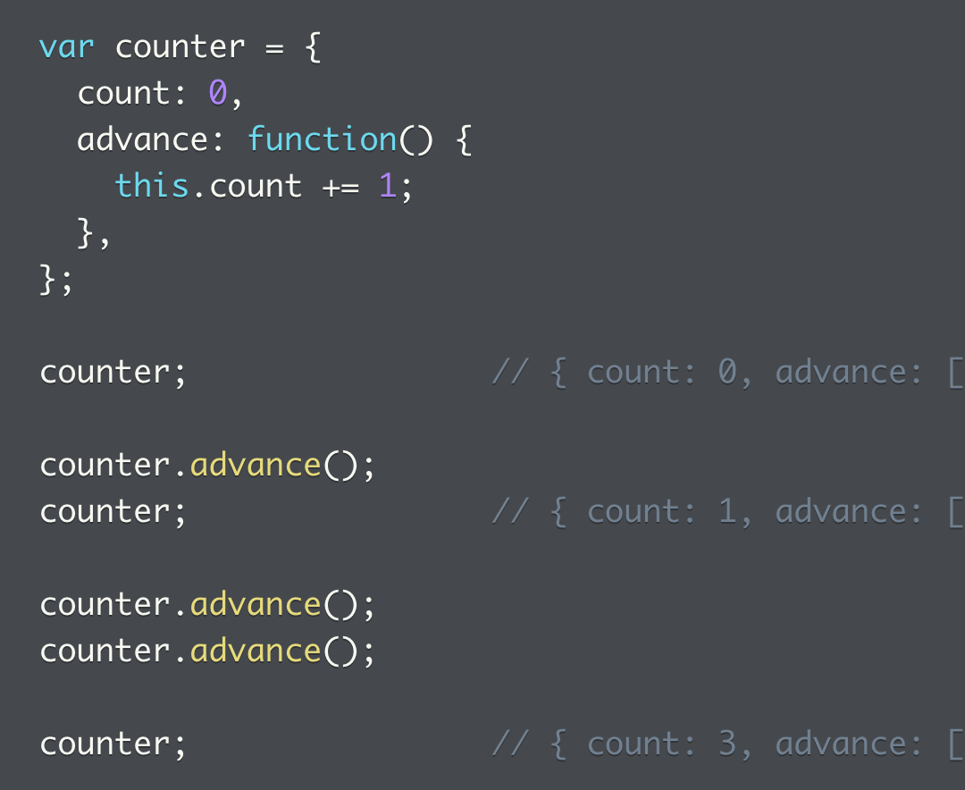
Objects and methods: this
`this` references the object itself
Within an object, `this` will always reference the object
A function can use `this` to access and change object properties

Slide 8
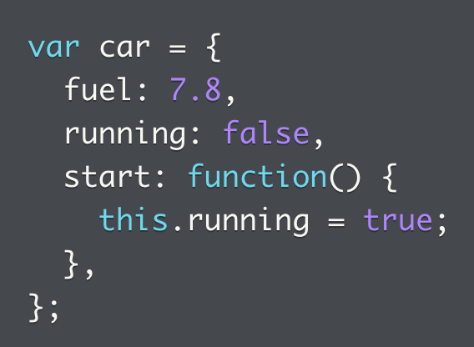
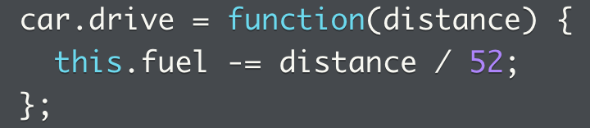
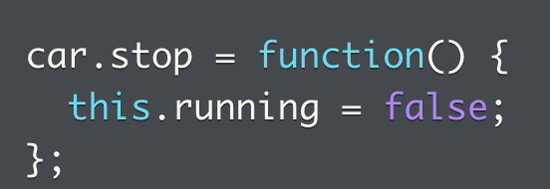
Objects and methods: object methods
Object methods have function value (unlike properties)
They can be defined when object is created
Can also be added later

Slide 9
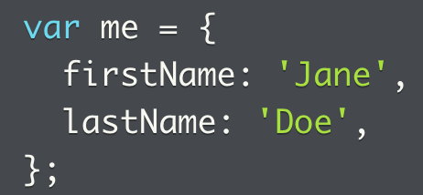
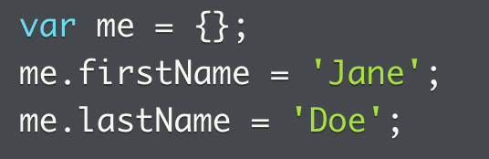
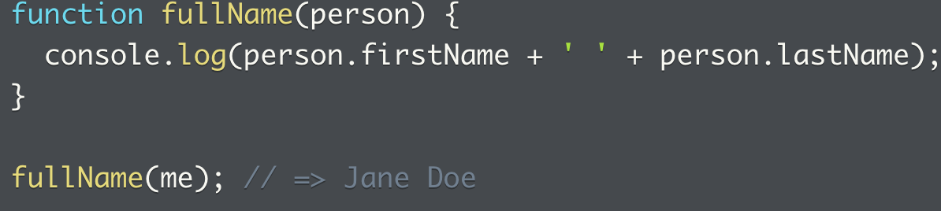
Walkthrough: object methods
How to use functions inside objects as methods
Properties can be instantiated when object is created, or add properties later with the dot notation
Functions can be created within an object, that’s an object method

Slide 10
Walkthrough: object methods
There’s a number of activities we can go further with this object
Have a property that collects all the object
Add objects to the collection with an `add()` method
Remove objects to the collection with a `remove()` method
Update objects in the collection (add if does not exists, update info if exists)
Add an index function to give each object a unique property
Helper methods
Validate the object called is valid (or not)
Validate the object already exists in the collection (or not)
Find the position of the object called
Get the object called
Finished code here:

Slide 11
Practice: objects
This is a problem that revolves around the idea of an invoice
The invoice has the following properties:
Unpaid, paid arrays
A method called add() that takes client name and number for what’s owed {name: ‘Starbucks’, amount: 300 }
Add method `totalDue` to compute total `amount` for contents
Create new invoices and call `totalDue` to compute unpaid invoice amount
Add `paid()` to store paid invoices, initialize empty array
Create `payInvoice` that takes client name as argument, if name matches, push invoice to `paid` property, if not, push to new array defined as local var. When loop ends, replace existing `unpaid` with newly created unpaid
Create method totalPaid()
Call payInvoice twice, then call totalPaid and totalDue

Slide 12
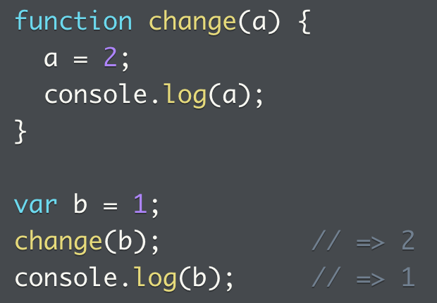
Mutating objects (1)
Some types can be mutated in JS, some can’t
What can’t? Primitive types, e.g. number, string, Boolean
They can be replaced but not changed
Most can be mutated:
Functions can change content of objects passed in as arguments
Code that references object see changes

Slide 13
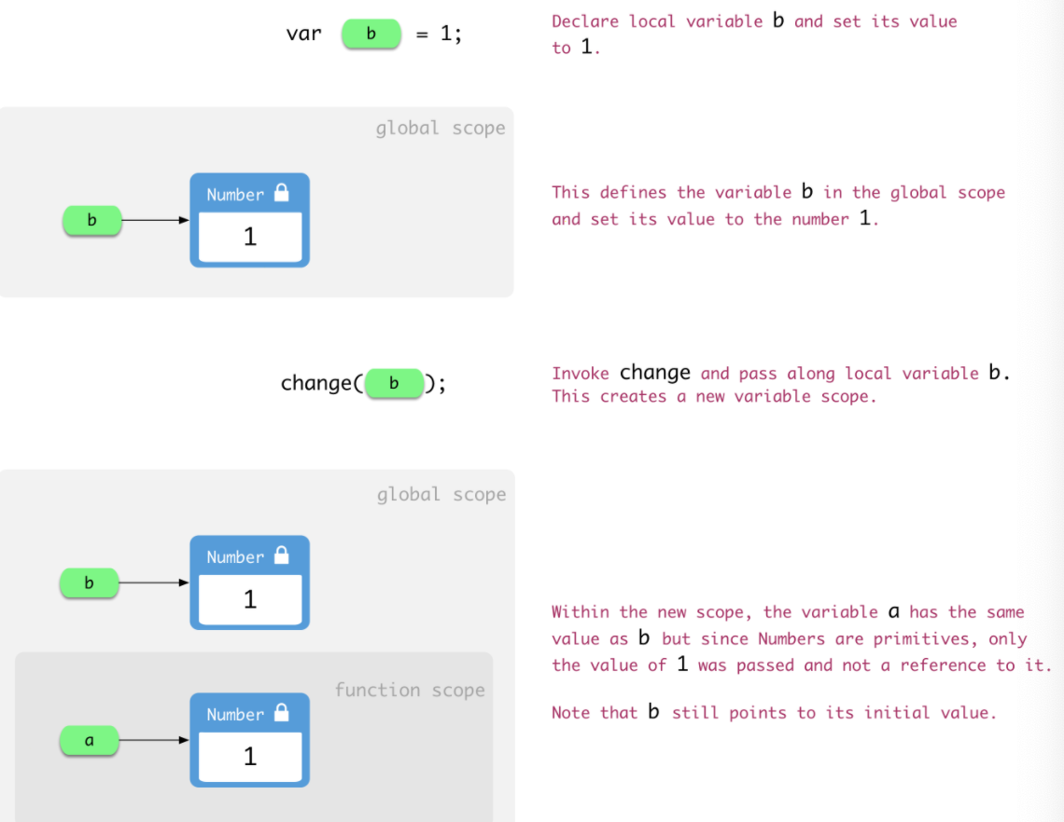
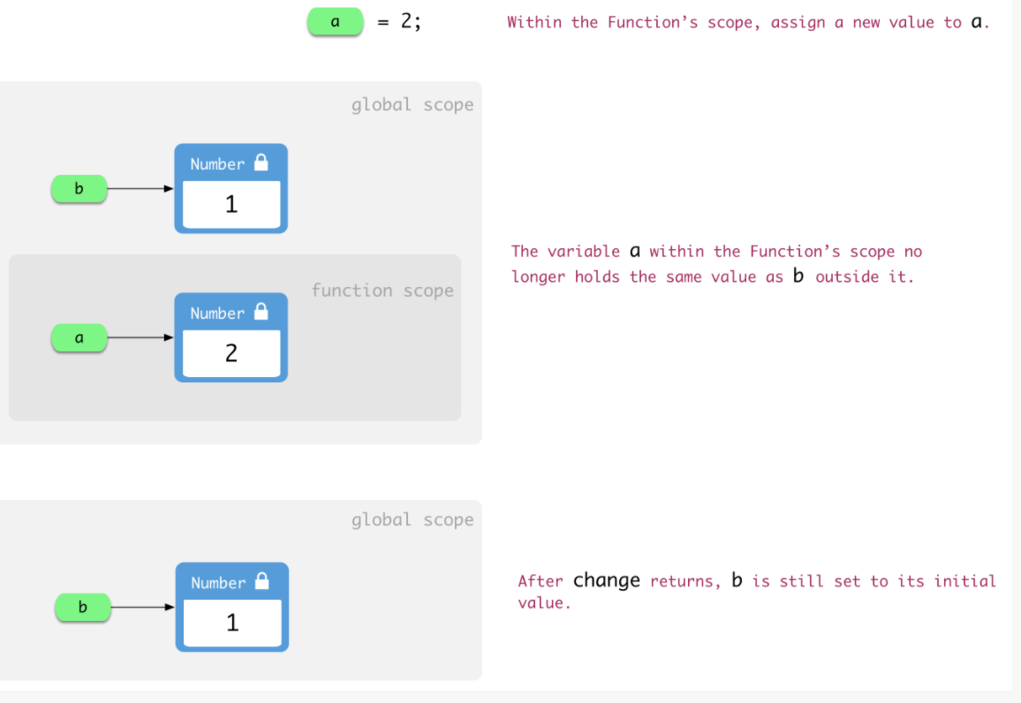
Mutating objects - primitive

Slide 14
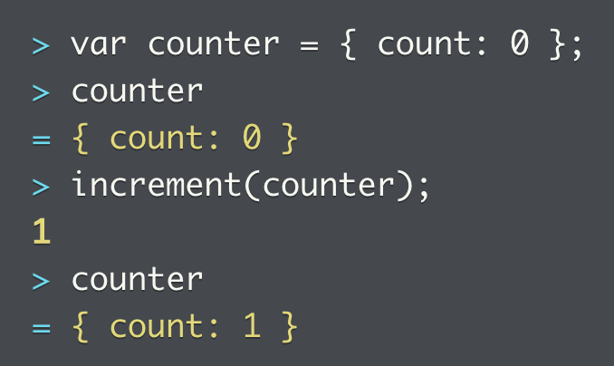
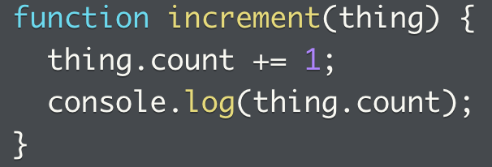
Mutating objects - objects
Objects can be modified through a function (see right, the increment() function modifies the calling object), where a property can be modified
They point to the same object, and alters the state of the object
What does the counter variable actually do? It holds a reference to the Object
When counter is passed to increment, JS references thing to make both thing and counter reference the same Object

Slide 15
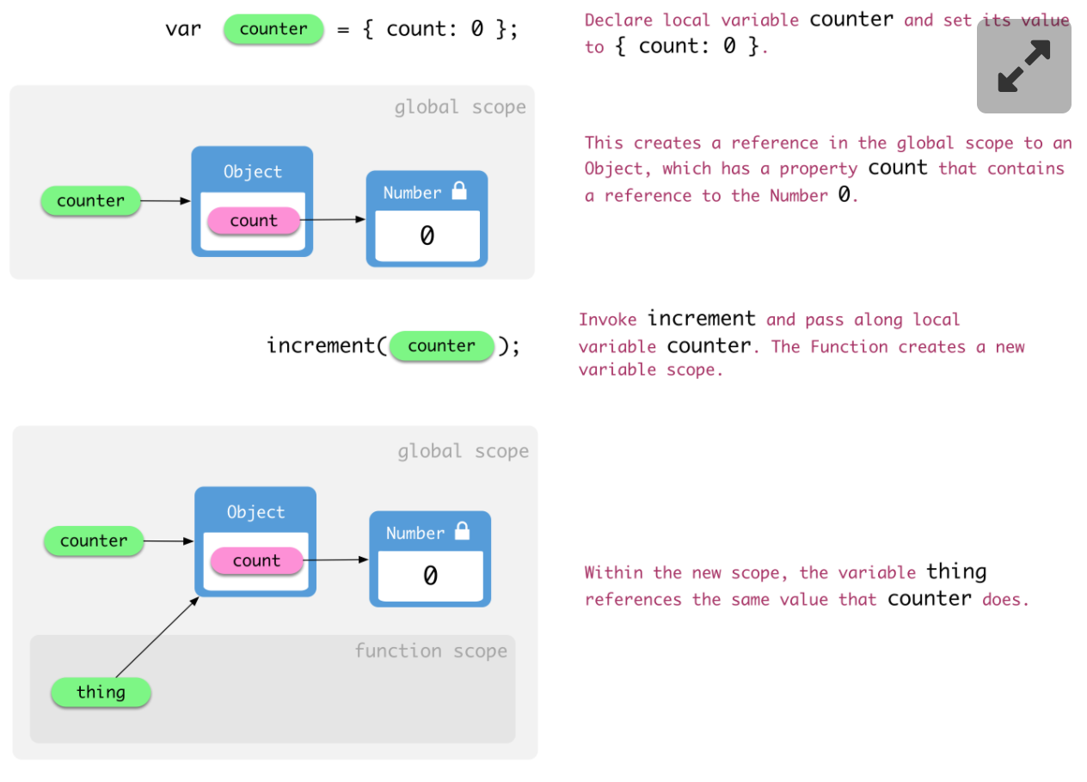
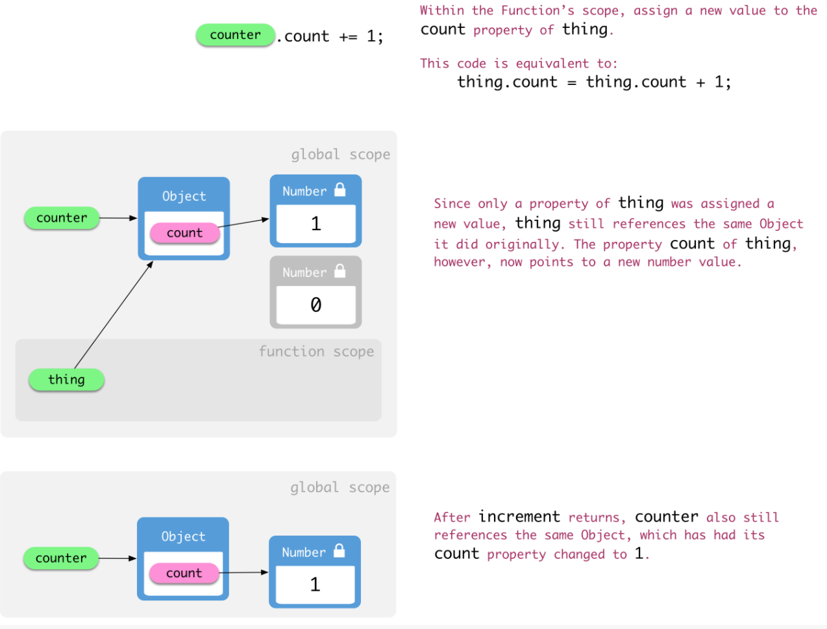
Mutating objects – objects (2)
When increment accesses thing, JS looks up thing reference, and finds Object, with count property modified in place
Both thing and counter point to Object, both see altered state of object
For more on behind the scene primitives vs. reference value/types and where they are stored (stack vs. heap), see this video: https://www.youtube.com/watch?v=9ooYYRLdg_g

Slide 16
Practice: mutating objects
Distinguish between global and functional scope
Mutability of object methods
Functional versus global scope and the mutability of a string
Copying an object, can you mutate the original object via the copied object? In essence, are they pointing to the same or different objects?
This shows object properties can be reassigned (also when those properties are objects themselves), and can reflect different values when invoked depending on when reassignment occurred.

Slide 17
Functions as object factories (1)
What is an object really?
A useful organizer that collects related data and behavior
Benefit is seen when app uses more than one instance of a given Object type
Example of a vehicle, this vehicle has the following properties
Speed
Rate (of acceleration)
Acceleration method that increases the speed
This allows user to interact with the object vehicle

Slide 18
Functions as object factories (2)
To avoid code duplication, we can create an interface that will allow the same type of object to be created each time
This can be achieved by creating a makeCar() function
This function can create more car objects
Allows braking
This is called an object factory, where a function can make objects in its image
Full code here

Slide 19
Practice problems: Functions as object factories
We want to create a factory function for objects representing countries
Create country objects with properties name, continents, getDescription()
Create a factory function that can make country objects in its image
Add property that tracks whether it’s been visited or not, visited()
Give the above property a default value
Add visitCountry() that sets visited() to true
Update getDescription()
Full code here

Slide 20
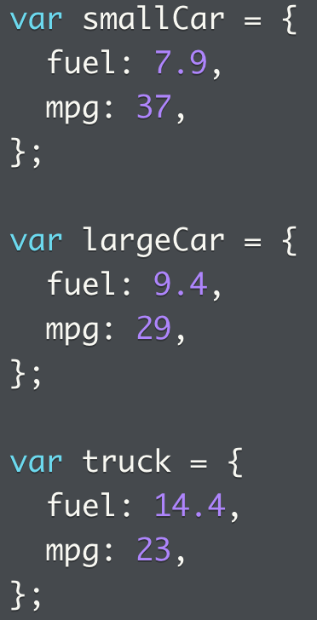
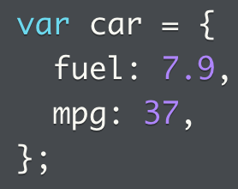
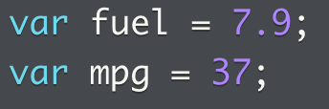
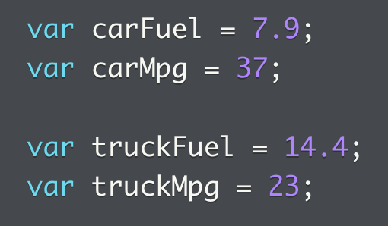
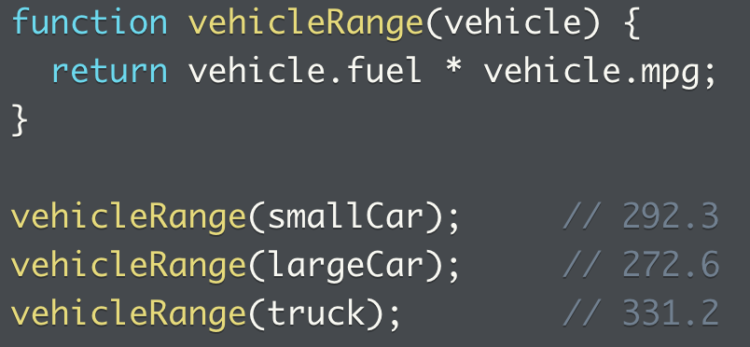
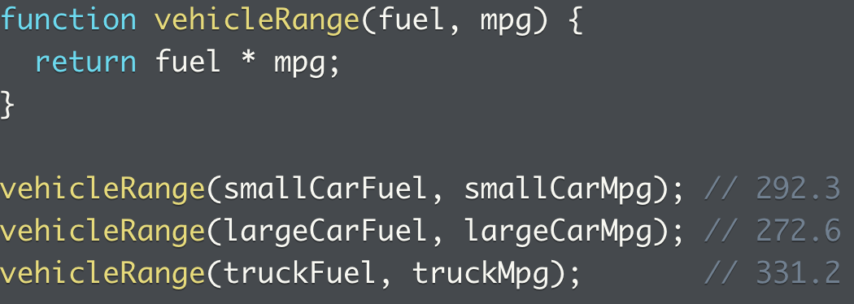
Object orientation (1)
Why do we use objects?
OOP is a programming pattern where objects are the building blocks of a program (instead of var and functions)
Using the same car example, we can see that just by assigning var to values can get out of hand once we have many objects

Slide 21
Object orientation (2)
This way, we can deal with smarter objects that performs action on the data they own, because data and procedures are contained in the same object
Complexity is moved inside an object and not exposed
When changes are made, they are restricted to those objects, maintenance is also easier
Instead of being a standalone function, vehicleRange can be put into the same object
Better yet, we can put the method into an object factory
Full code here

Slide 22
Object orientation (2)
Questions to ask when using OOP
What are the important concepts in the program?
What are the properties of a vehicle?
How do we create vehicles?
What operations can I perform on a vehicle?
Where should we add new properties and methods?
What do objects do?
Organize related data and code
Useful when program needs > 1 of something
More useful as codebase size increases

Slide 23
Practice: Object orientation
We are setting up an inventory management system
How to organize object properties in a way that makes sense, with properties like id, name, stock, price
Set up a function that allows an object passed in, with its price as a second argument
Check price is not negative
Add describeProduct(item) function
Add describeProduct() and setProductPrice() methods
Add createProduct(), setPrice, and describe
Remove two objects, recreate using createProduct
Full code here

Slide 24
Objects exercises
Full code here

Slide 25
Objects quiz
Full quiz here

